Slide 1
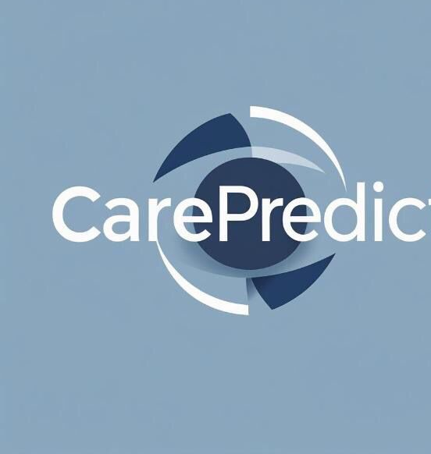
CarePredictAI
Smart Patient Management System

Slide 2

Problem Definition
• Long queues delay access to care
• Patients with low risk wait same as high risk
• Overwhelms staff, reduces satisfaction
• Lack of prediction tools for urgent cases

Slide 3
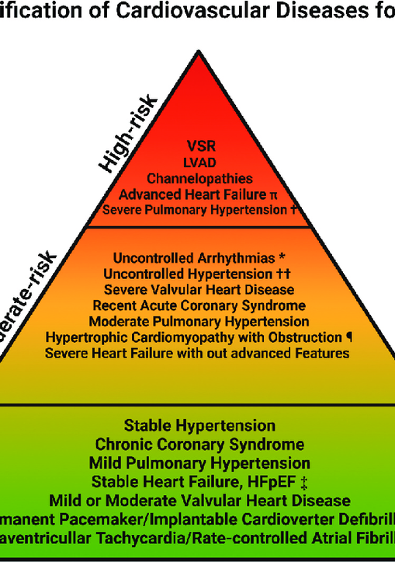

Business Objectives
• Predict patient risk levels at entry
• Classify patients: critical, moderate, low risk
• Reduce waiting times
• Chatbot for patient information entry
• Support doctors & admins in decision-making

Slide 4

Business Background
• Built for South African healthcare facilities
• Sorts patients by risk using symptoms
• Chatbot check-in system
• Powered by Python ML models
• Scalable to hospitals & clinics nationwide

Slide 5
Requirements
• Patient datasets: admissions, diagnoses, demographics
• Staff training for chatbot/AI usage
• Secure patient data storage
• Python ML models for predictions

Slide 6

Constraints
• Missing or imbalanced data records
• Limited availability of quality datasets
• Staff resistance to new tech
• Infrastructure limits in rural areas
• Ethical & government approval concerns

Slide 7
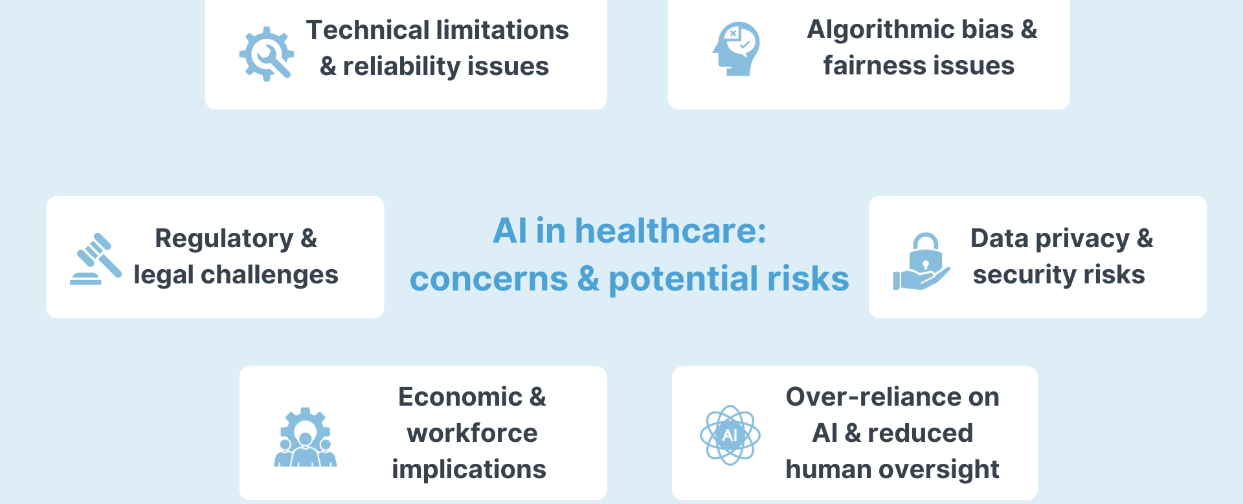
Risks
• Technical: overfitting, slow training
• Ethical: misuse without oversight
• Data privacy breaches
• High implementation costs

Slide 8
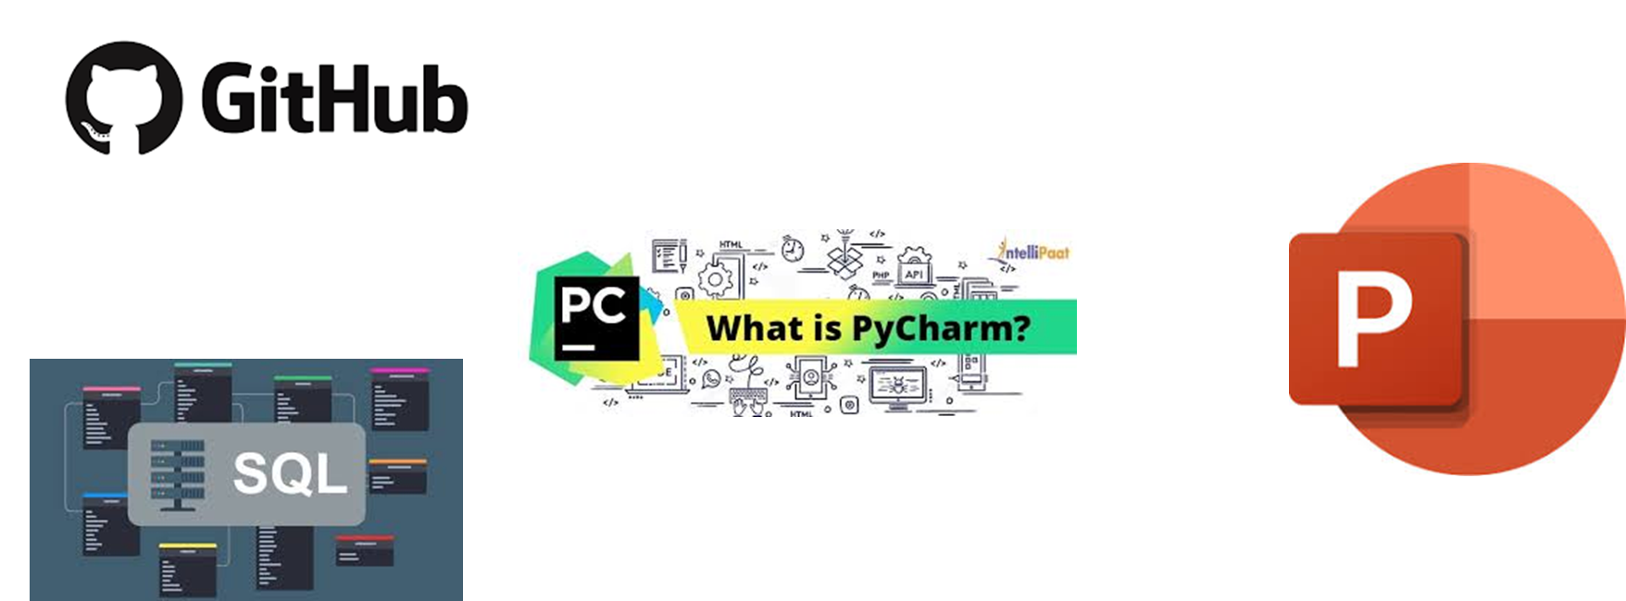
Tools & Techniques
• PyCharm: AI model & chatbot development
• SQL: patient data management
• PowerPoint: solution presentations
• GitHub: collaboration & version control

Slide 9

AI Solution
• Patient registers via chatbot
• Enters details: name, age, symptoms
• AI estimates risk level
• Generates unique patient ID
• Reduces waiting lines, helps doctors prepare

Slide 10

Conclusion
• AI improves hospital efficiency & saves lives
• Reduces waiting lines via chatbot check-in
• Prototype shows promise despite limitations
• Scalable impact for South Africa and beyond

